Slide 1
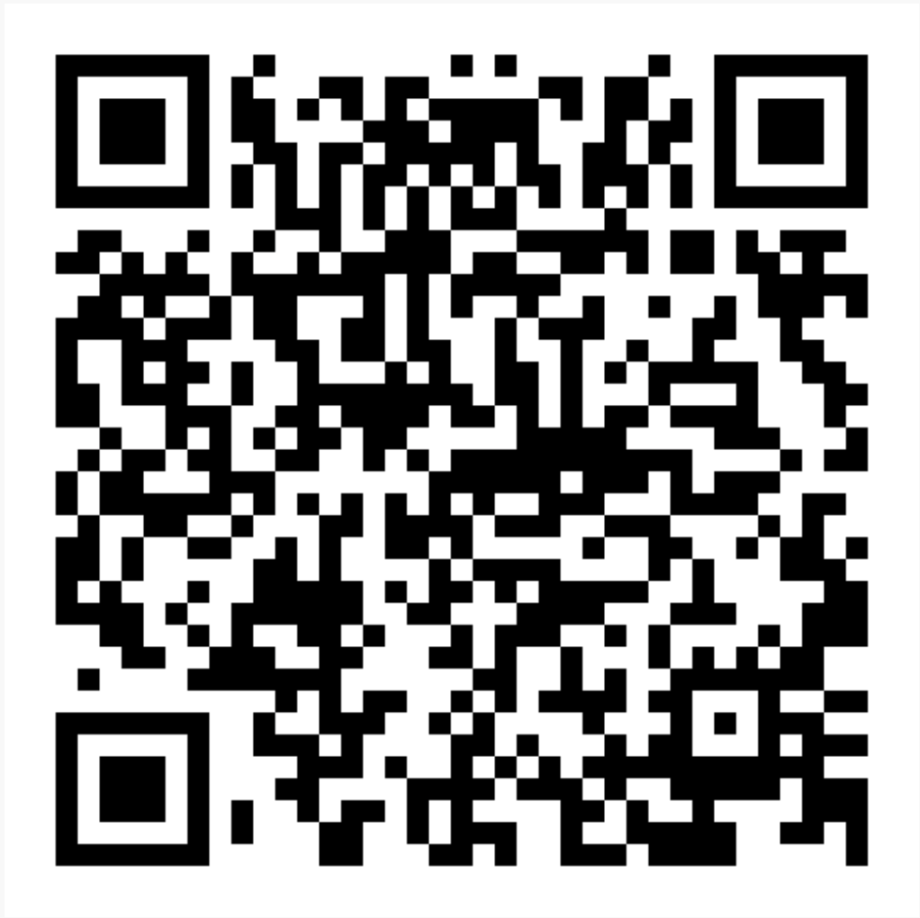
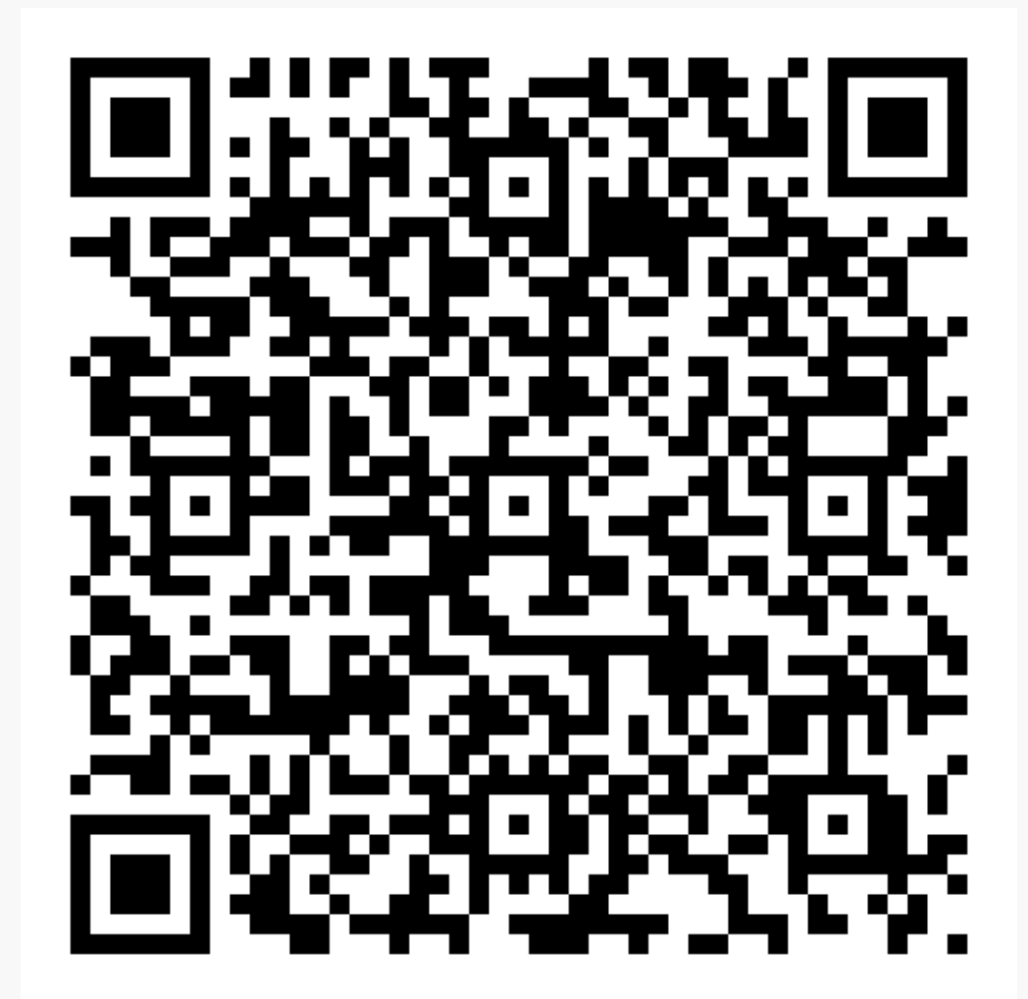
Perceived Accessibility
Unveiling Inequalities in Transport Justice
Lars E Olsson Karlstad University
Katrin Lättman, University of Gävle

Slide 2

Every individual within a specific geographical area can´t be expected to experience the same level of accessibility

Slide 3
Perceived Accessibility Scale - PAC
Considering how I travel today it is easy to do my daily activities
Considering how I travel today I am able to live my life as I want to
Considering how I travel today I am able to do all activities I prefer
Access to my preferred activities is satisfying considering how I travel today

Slide 4

Equality in accessibility
Who are we planning for?
Who are particular services beneficial for?
Who is left behind?

Slide 5
PUBLICATIONS

Slide 6
… BUT …
HOW CAN PAC BE USED IN PRACTICE?

