Slide 1
Mobility challenges through a living lab app:
shaping the notion of citizenship
Moderator: Jessica Berg VTI

Slide 2


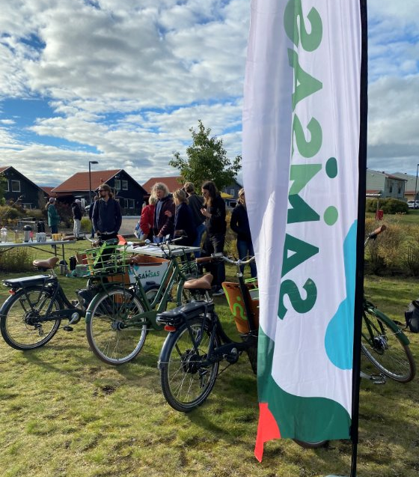
Challenges as triggers for transformation?
14 citizens got challenges in the ”SAMSAS” app, from November 2022 to September 2023
1. How do living lab participants experience and describe everyday mobility from a local perspective?
2. In what ways can participation in a living lab challenge mobility practices?
3. In what ways can participation in a living lab encourage reflections on citizenship?
They received 11 mobility and 6 citizen challenges during 10 months
Notes:
1. Hur upplever och beskriver deltagarna i living labbet deras vardagsmobilitet i Riksten? 2. På vilka sätt kan deltagande i ett living lab utmana deras mobilitetspraktiker? 3. På vilka sätt kan deltagande i ett living lab uppmuntra till reflektioner kring medborgarskap?

Slide 3
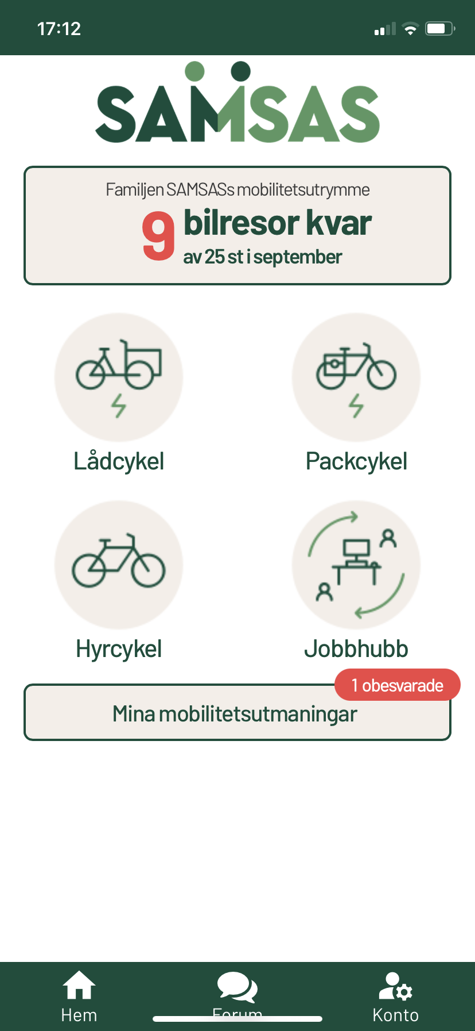
The SAMSAS-app
Links living lab, citizens and researchers
Book services
Encourage active participation
Visualize car trips
Post reflections on mobility and citizenship
Develop sustainable practices
Notes:
Denna bild visar vilka funktioner appen hade och hur den kopplar samman deltagarna med livinglabbet och oss forskare. Inte minst hade arbetssättet med appen och utmaningar en metodologisk vinst, genom att det uppmuntrade deltagarna att aktivt vara involverade under hela 10 månader.

Slide 4
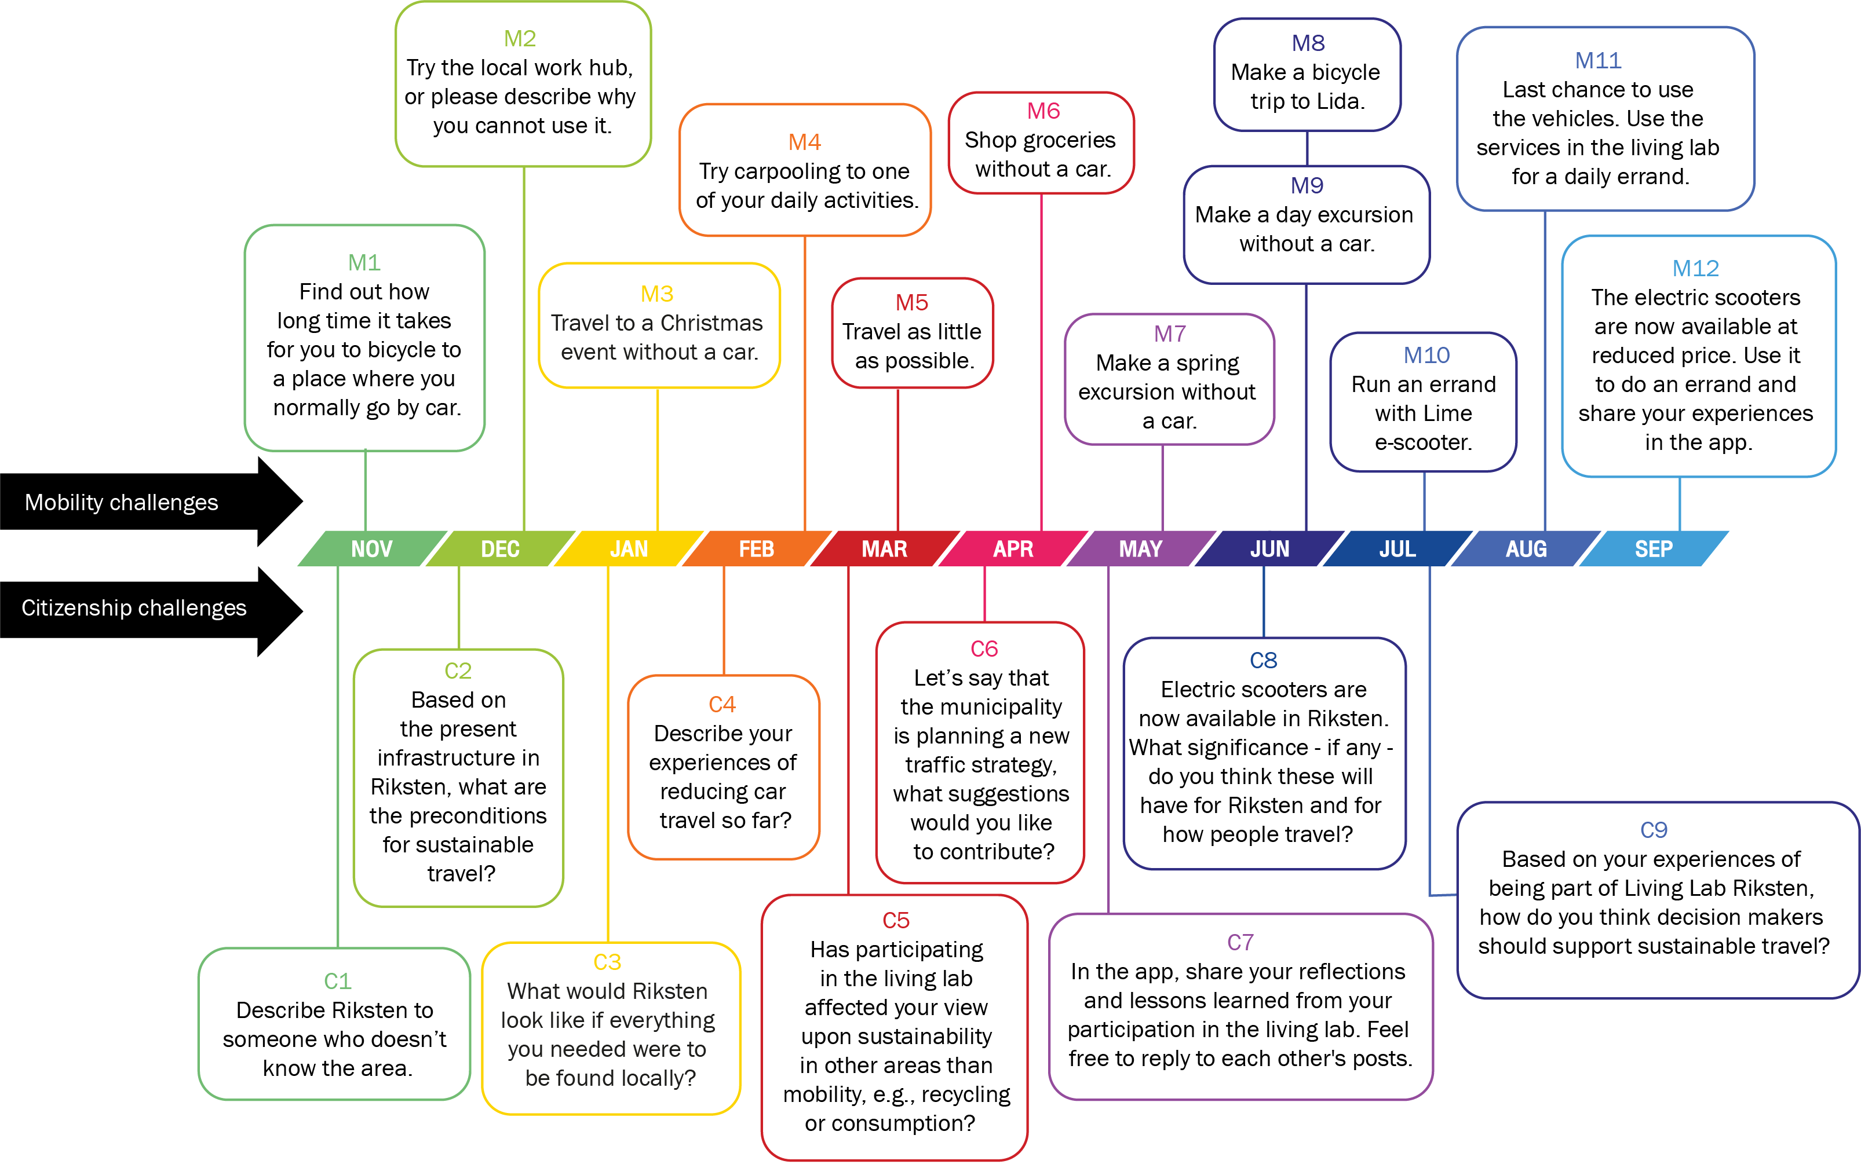
Notes:
Samtliga utmaningar och när de skickades ut.

Slide 5
What have we learned from working with challenges in a living lab app?
The study showed that it is possible to appeal to people both as travellers and as citizens and get informative reports from them in both respects. By applying the challenge method, we were able to discern civic spirit and commitment, ‘for the group’, as well as for individuals.
Participants ask for public transport that is seamless and easily available, with frequent feeder traffic, despite (other) services being available in the living lab
Citizens show and interest to discuss and being involved in the political debate
The participants view the local space as configured to support motorists, and we ask therefore: are cyclists, pedestrians and public transport users barely citizens?
Notes:
The study showed that it is possible to appeal to people both as travellers and as citizens and get informative reports from them in both respects. By applying the challenge method, we were able to discern civic spirit and commitment, ‘for the group’, as well as for individuals.
Given that the study is based on mobility practices in the outskirts of a city, participants ask for public transport that is seamless and easily available, with frequent feeder traffic, despite services made available in the living lab
There seems to be an interest among citizens to discuss where society at different levels should be heading in terms of planning and transport. This gives rise to questions around arenas for political debate to create legitimacy, but also to enable citizens to raise their voices and provide policymakers and civil servants with new perspectives.
The participants view the local space as configured to support motorists. The living lab participants’ reports reflect that Riksten is seen as a district where car use is considered convenient for everyday mobility, while public transport is regarded as insufficient, time consuming and unsafe. .And we ask: are cyclists, pedestrians and public transport users ‘barely citizens’?

Slide 6
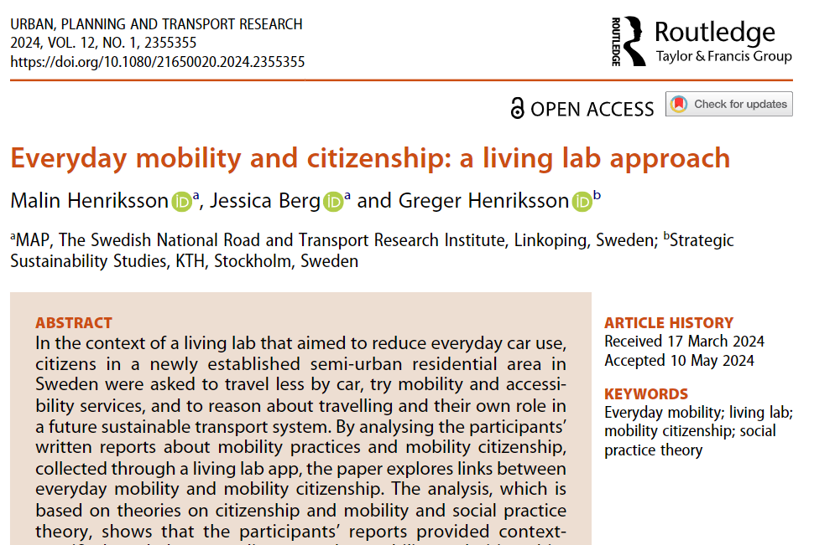

Slide 7


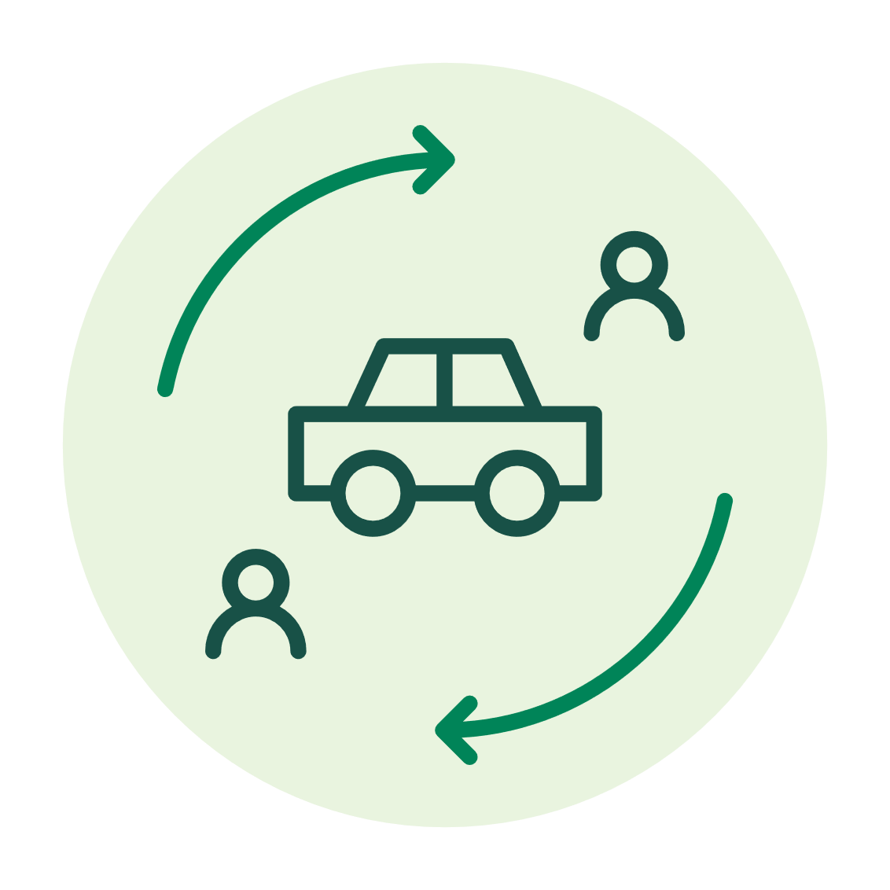



Thank you for listening!
Questions and reflections?
Notes:
Do you think that challenges such as those we used can be used by local stakeholders to encourage transformation?

