Slide 1
Political leadership for sustainable mobility transformations
Karin Thoresson and Karolina Isaksson, VTI
Notes:
Transformative change is political
Politicians a central role

Slide 2
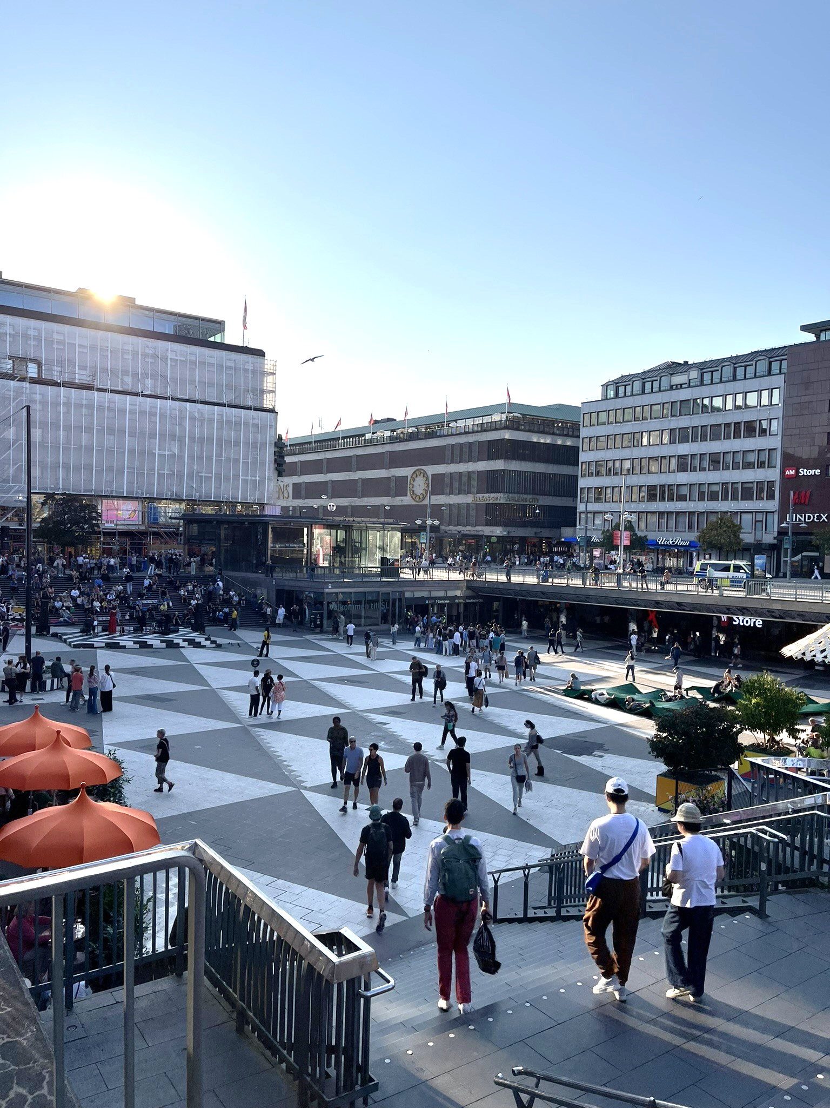
What does it take to exercise political leadership at the local level?
Credit: Karolina Isaksson
Notes:
Our study
Definition of political leadership
Champions vs collaboration

Slide 3
What did we find?

Slide 4
Publicly owned companies, parking, properties
Administration, planners
Politicians in other committees
National political and
administrative level
Politicians
Other political parties
Citizens
Silent group
Ones voters
Interest groups, NGO:s, lobbying
’Public opinion’
Debate, criticism
Notes:
The politicians we interviewed
Pushing for transformative change...
...relate to a broad range of actors

Slide 5
Publicly owned companies, parking, properties
Administration, planners
Politicians in other committees
National political and
administrative level
Politicians
Other political parties
Citizens
Silent group
Ones voters
Interest groups, NGO:s, lobbying
’Public opinion’
Debate, criticism

Slide 6
Publicly owned companies, parking, properties
Administration, planners
Politicians in other committees
National political and
administrative level
Politicians
Other political parties
Citizens
Silent group
Ones voters
Interest groups, NGO:s, lobbying
’Public opinion’
Debate, criticism
Notes:
The politicians relate a lot to local residents
different groups
Expectations from own voters
Strong voices vs silent groups
Pressures from both sides

Slide 7
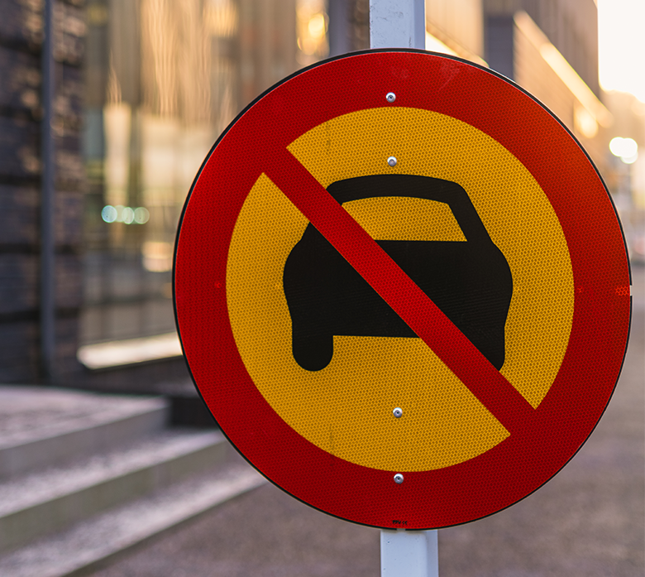
No Vehicle Entry Sign On Urban Street During Daylight Hours
Credit: iStock/Mikael Svensson
Notes:
Conflicts = a key theme in the interviews. And not only in negative terms.
Part of the job.
And referred to as a source of political energy, mobilization.
Opposition to car restrictive measures = sometimes challenging but potentially also meaningful.
A way to get down to political values and priorites.
One challenge = how to make strategies for sustainable transport and mobility comprehensible, beyond the common technical framings.
Climate change = tricky to communicate. Feels abstract.
Actively make use of other framings, such as attractive and healthy cities, right to access for different groups, focus on land use.
Build a narrative which focuses less on what is lost, and more on what could be created.
Local places = can be used to visualise and explain what sustainable mobility and land use can be about in practice.
Make it more tangible and easier to grasp.

Slide 8
Publicly owned companies, parking, properties
Administration, planners
Politicians in other committees
National political and
administrative level
Politicians
Other political parties
Citizens
Silent group
Ones voters
Interest groups, NGO:s, lobbying
’Public opinion’
Debate, criticism
Notes:
The last type of relation we want to highlight is with the administration (planners and other civil servants)
Important source of information and knowledge
Provides decision makers with sound decision support, basis for action
This takes trust and hard work from both the politicians and the administration
”the administration gets the politicians they deserve”
Poor work from admin = insufficient political leadership (and the other way around)

Slide 9
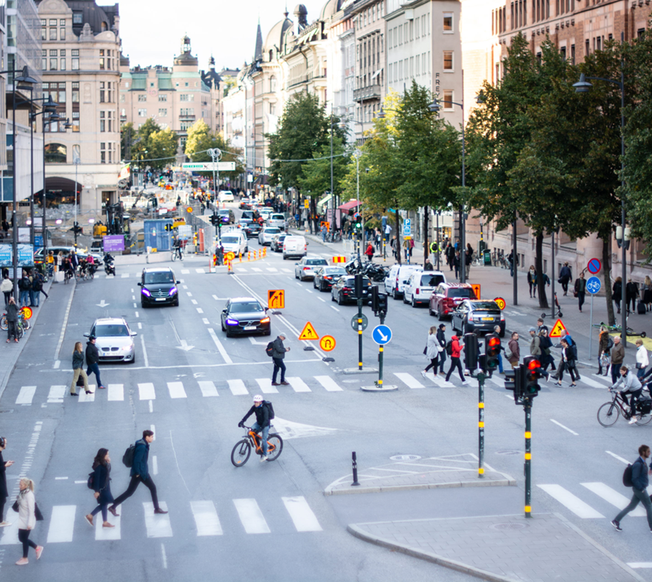
Political leadership
Is relational
Is a constant navigation of conflict and collaboration
Requires professional knowledge and political imagination
The local context, place and time is of key importance
Credit: VTI
Notes:
To conclude, what we learned from the interviews with these politicians who have all worked with potentially transformative measures for sustainable mobility in their own local contexts, was that political leadership:
*is deeply relational (network of relations)
*requires a constant navigation of conflict and collaboration
*is dependent on robust knowledge support but also creativity and oppenness to imagine and try new pathways.
To make this happen, the local context, the specific time and place and the actors and networks around are essential. Because the local environment, and the lives and relationships that exist there, provide special conditions not only for imagining possible futures, but also start to try these out in practice.

Slide 10
Thank you!
karolina.isaksson@vti.se karin.thoresson@vti.se

