Slide 1
Climate demands on transport systems
Mattias Höjer with Jonas Åkerman and Hampus Berg Mårtensson

Slide 2
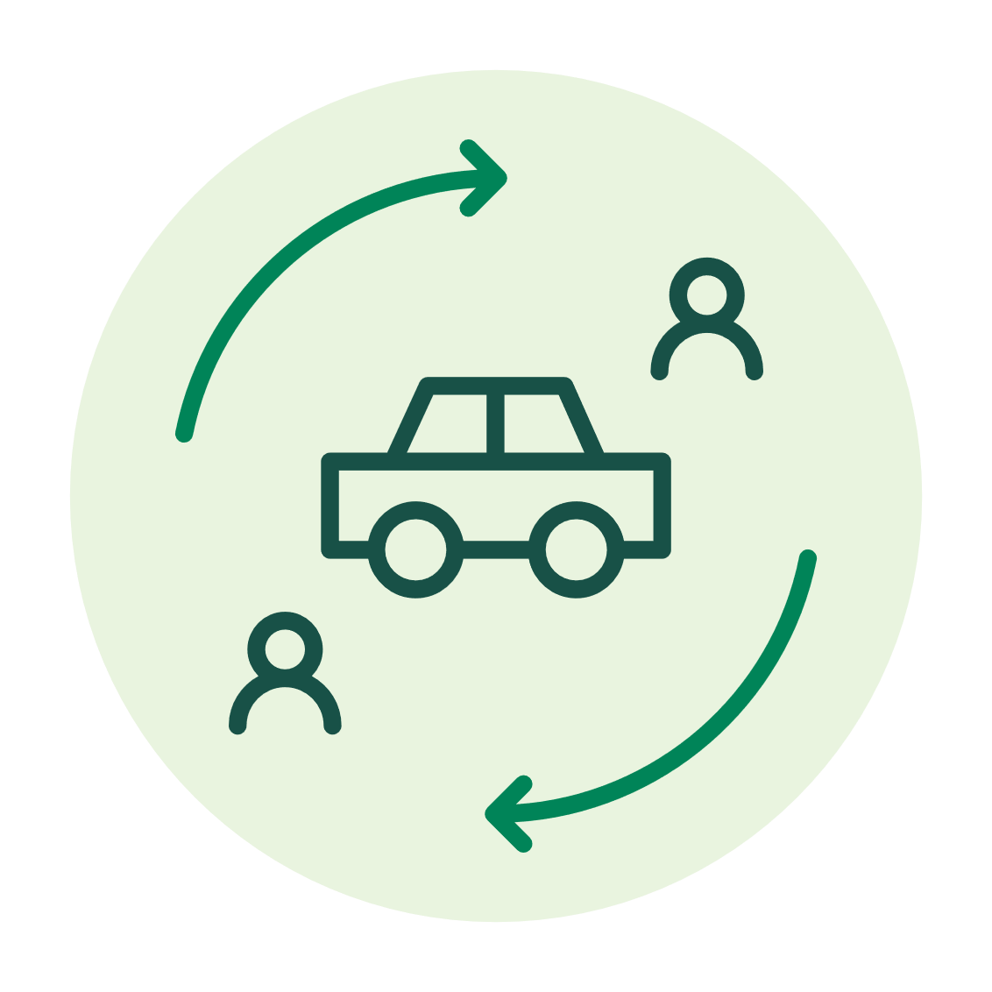
Transport futures
Yearly pkm/capita
kWh/pkm
Yearly tonkm/capita
25.000
0
0.5
1
25.000
13. Bicycle
12. Coach, Electric, Long
11. Rail, Electric, Long
10. Coach, ICE, Long
9. Car, Electric, Long
8. Rail, Electric, Short
7. Car, Electric, Short
6. Bus, Electric, Short
5. Bus, ICE, Short
4. Car, ICE, Long
3. Air
2. Car, ICE, Short
1. Ferry
0
0.5
kWh/tonkm
6. 7. 8. 9. 10. 11. 12.13.
1
20.000
F.
E.
D.
C.
B.
A.
20.000
5.
4.
3.
2.
1.
Preliminary results – Do not cite!
10.000
10.000
F. Rail
E. Cargo ship
D. Heavy Truck, Electric
C. Ferry
B. Heavy Truck, ICE
A. Air freight
2018, 106 TWh
Trend 2035, 87 TWh
Sustainable 2035, 57 TWh
Notes:
I will mix two studies on sustainable transport systems. Compared to what you will hear later on this will be more based on studies of the whole transport system and more more based on quantitative modelling. We hope you will like the variations in approaches that you will see.

Slide 3


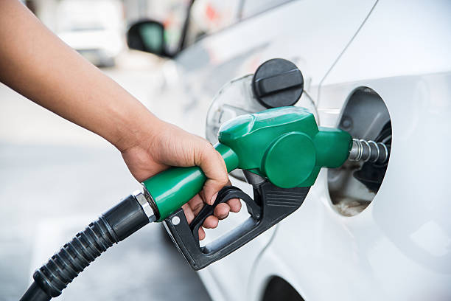
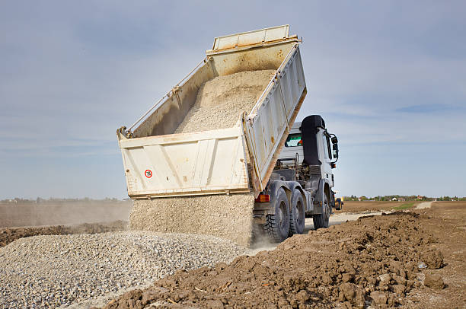
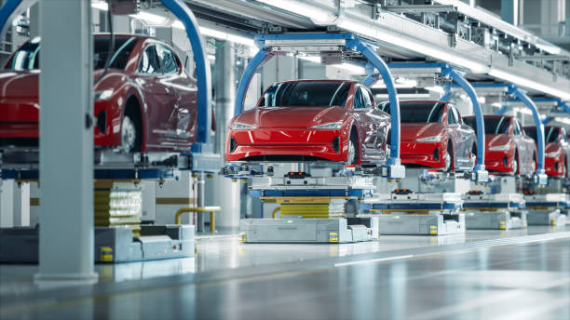
Two studies with slightly different scopes
What would car traffic in Sweden look like, if fulfilling climate targets (-70%, 2010-2030)?
What would the Swedish transport system look like, if fulfilling climate targets?
Car traffic
All modes of transport
Fuel production
Vehicle manufacturing
Infrastructure
Notes:
First study: car traffic. Only fuel and

Slide 4

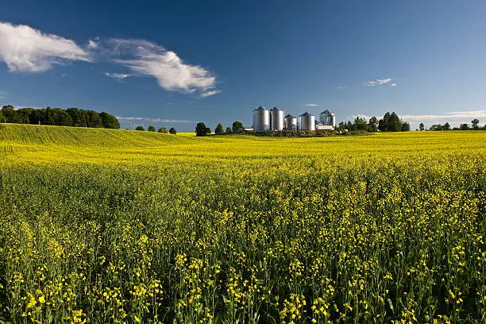

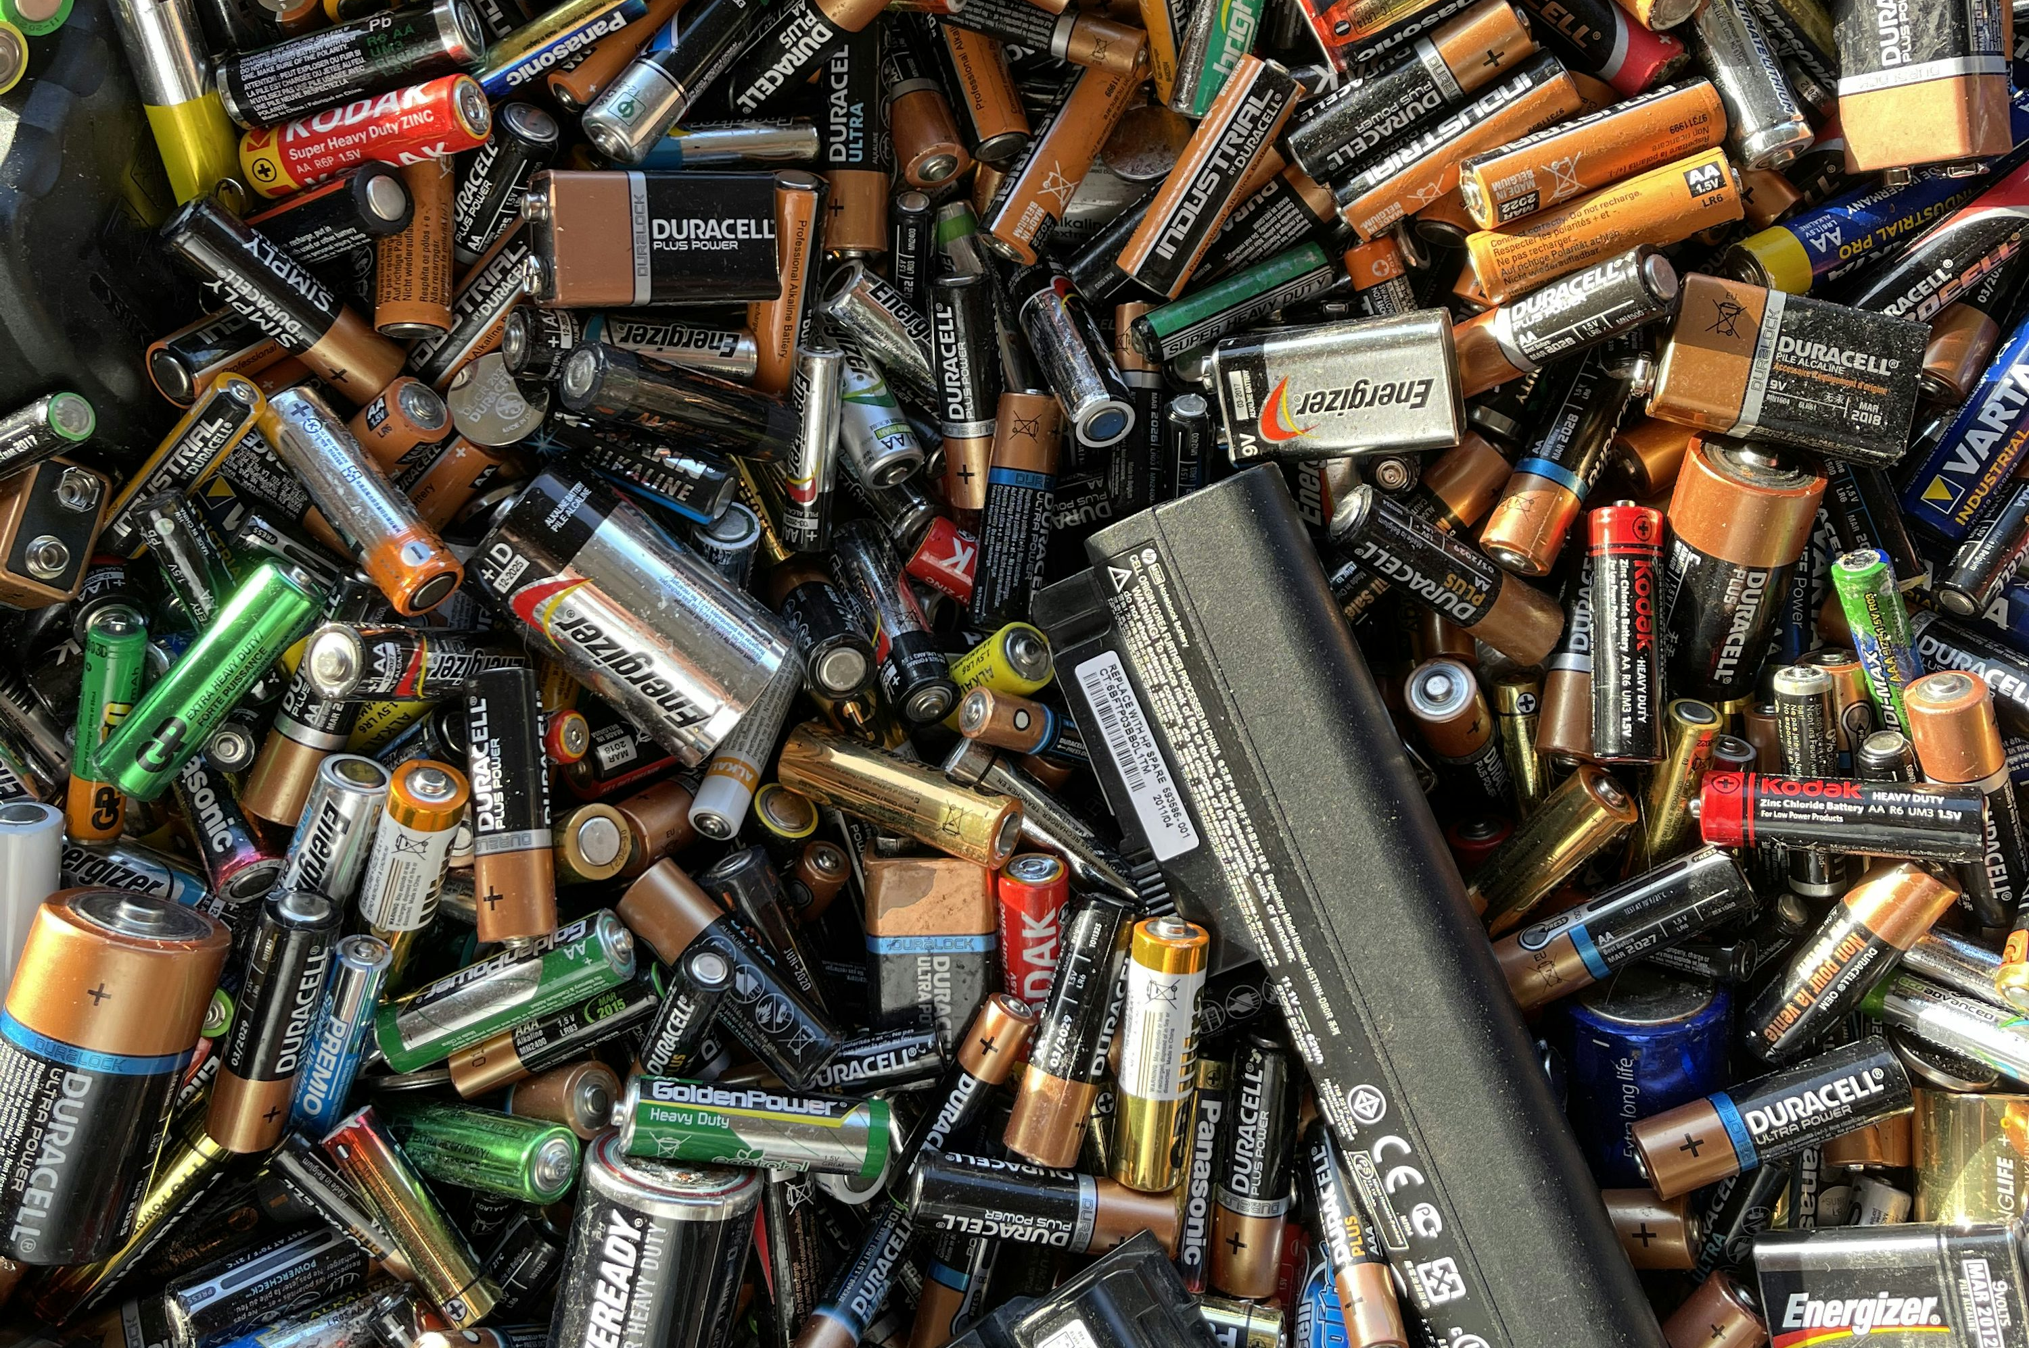
What would car traffic in Sweden look like, if fulfilling climate targets?
Electrification
Bio fuels
Car sharing
Efficiency in battery use
Notes:
Electrification
Car sharing
Bio fuels
Efficiency in battery use

Slide 5
A. 20-50 % reduced car driving

Slide 6
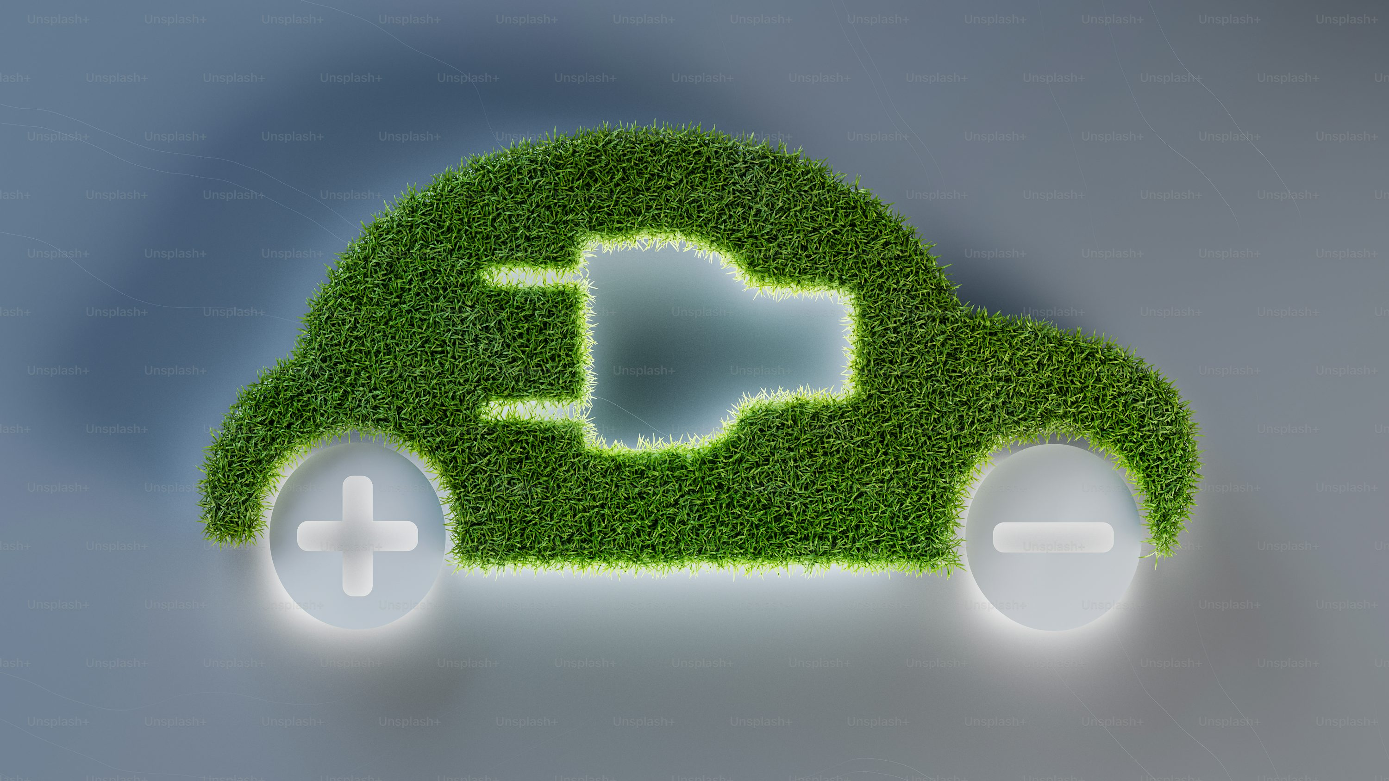
B. Electrification can reduce emissions from driving, but high-electrification scenarios cause serious problems in terms of emissions from production of cars, when the car fleet is to be exchanged
Notes:
Electrification can reduce emissions from driving, but high-electrification scenarios causes serious problems in terms of emissions from production of cars, when the car fleet is to be exchanged

Slide 7
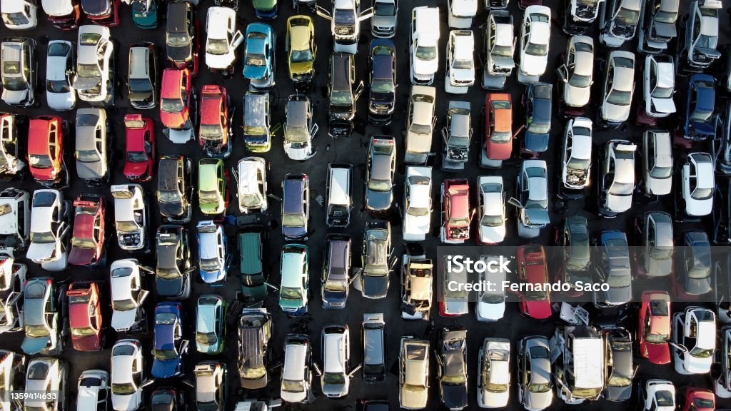
C. A renewal of the car fleet will require large scrapping

Slide 8

When looking at the whole transport system, see see:
1. Territorial targets risk underestimating mitigation challenge
(Swedes’ transport cause 40% of total consumption based GHG-emissions)

Slide 9
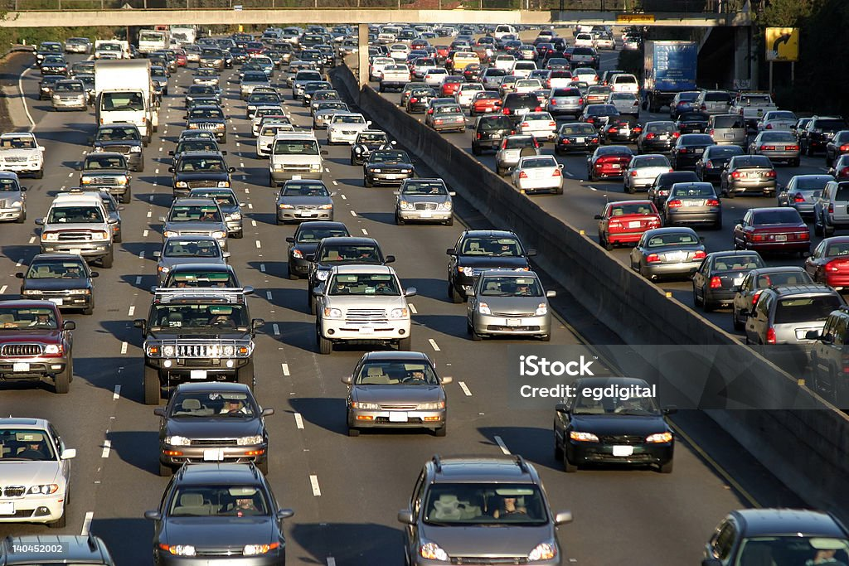
2. Low occupancy increases importance of commuting
(to 45% of GHG emissions from car travel)

Slide 10
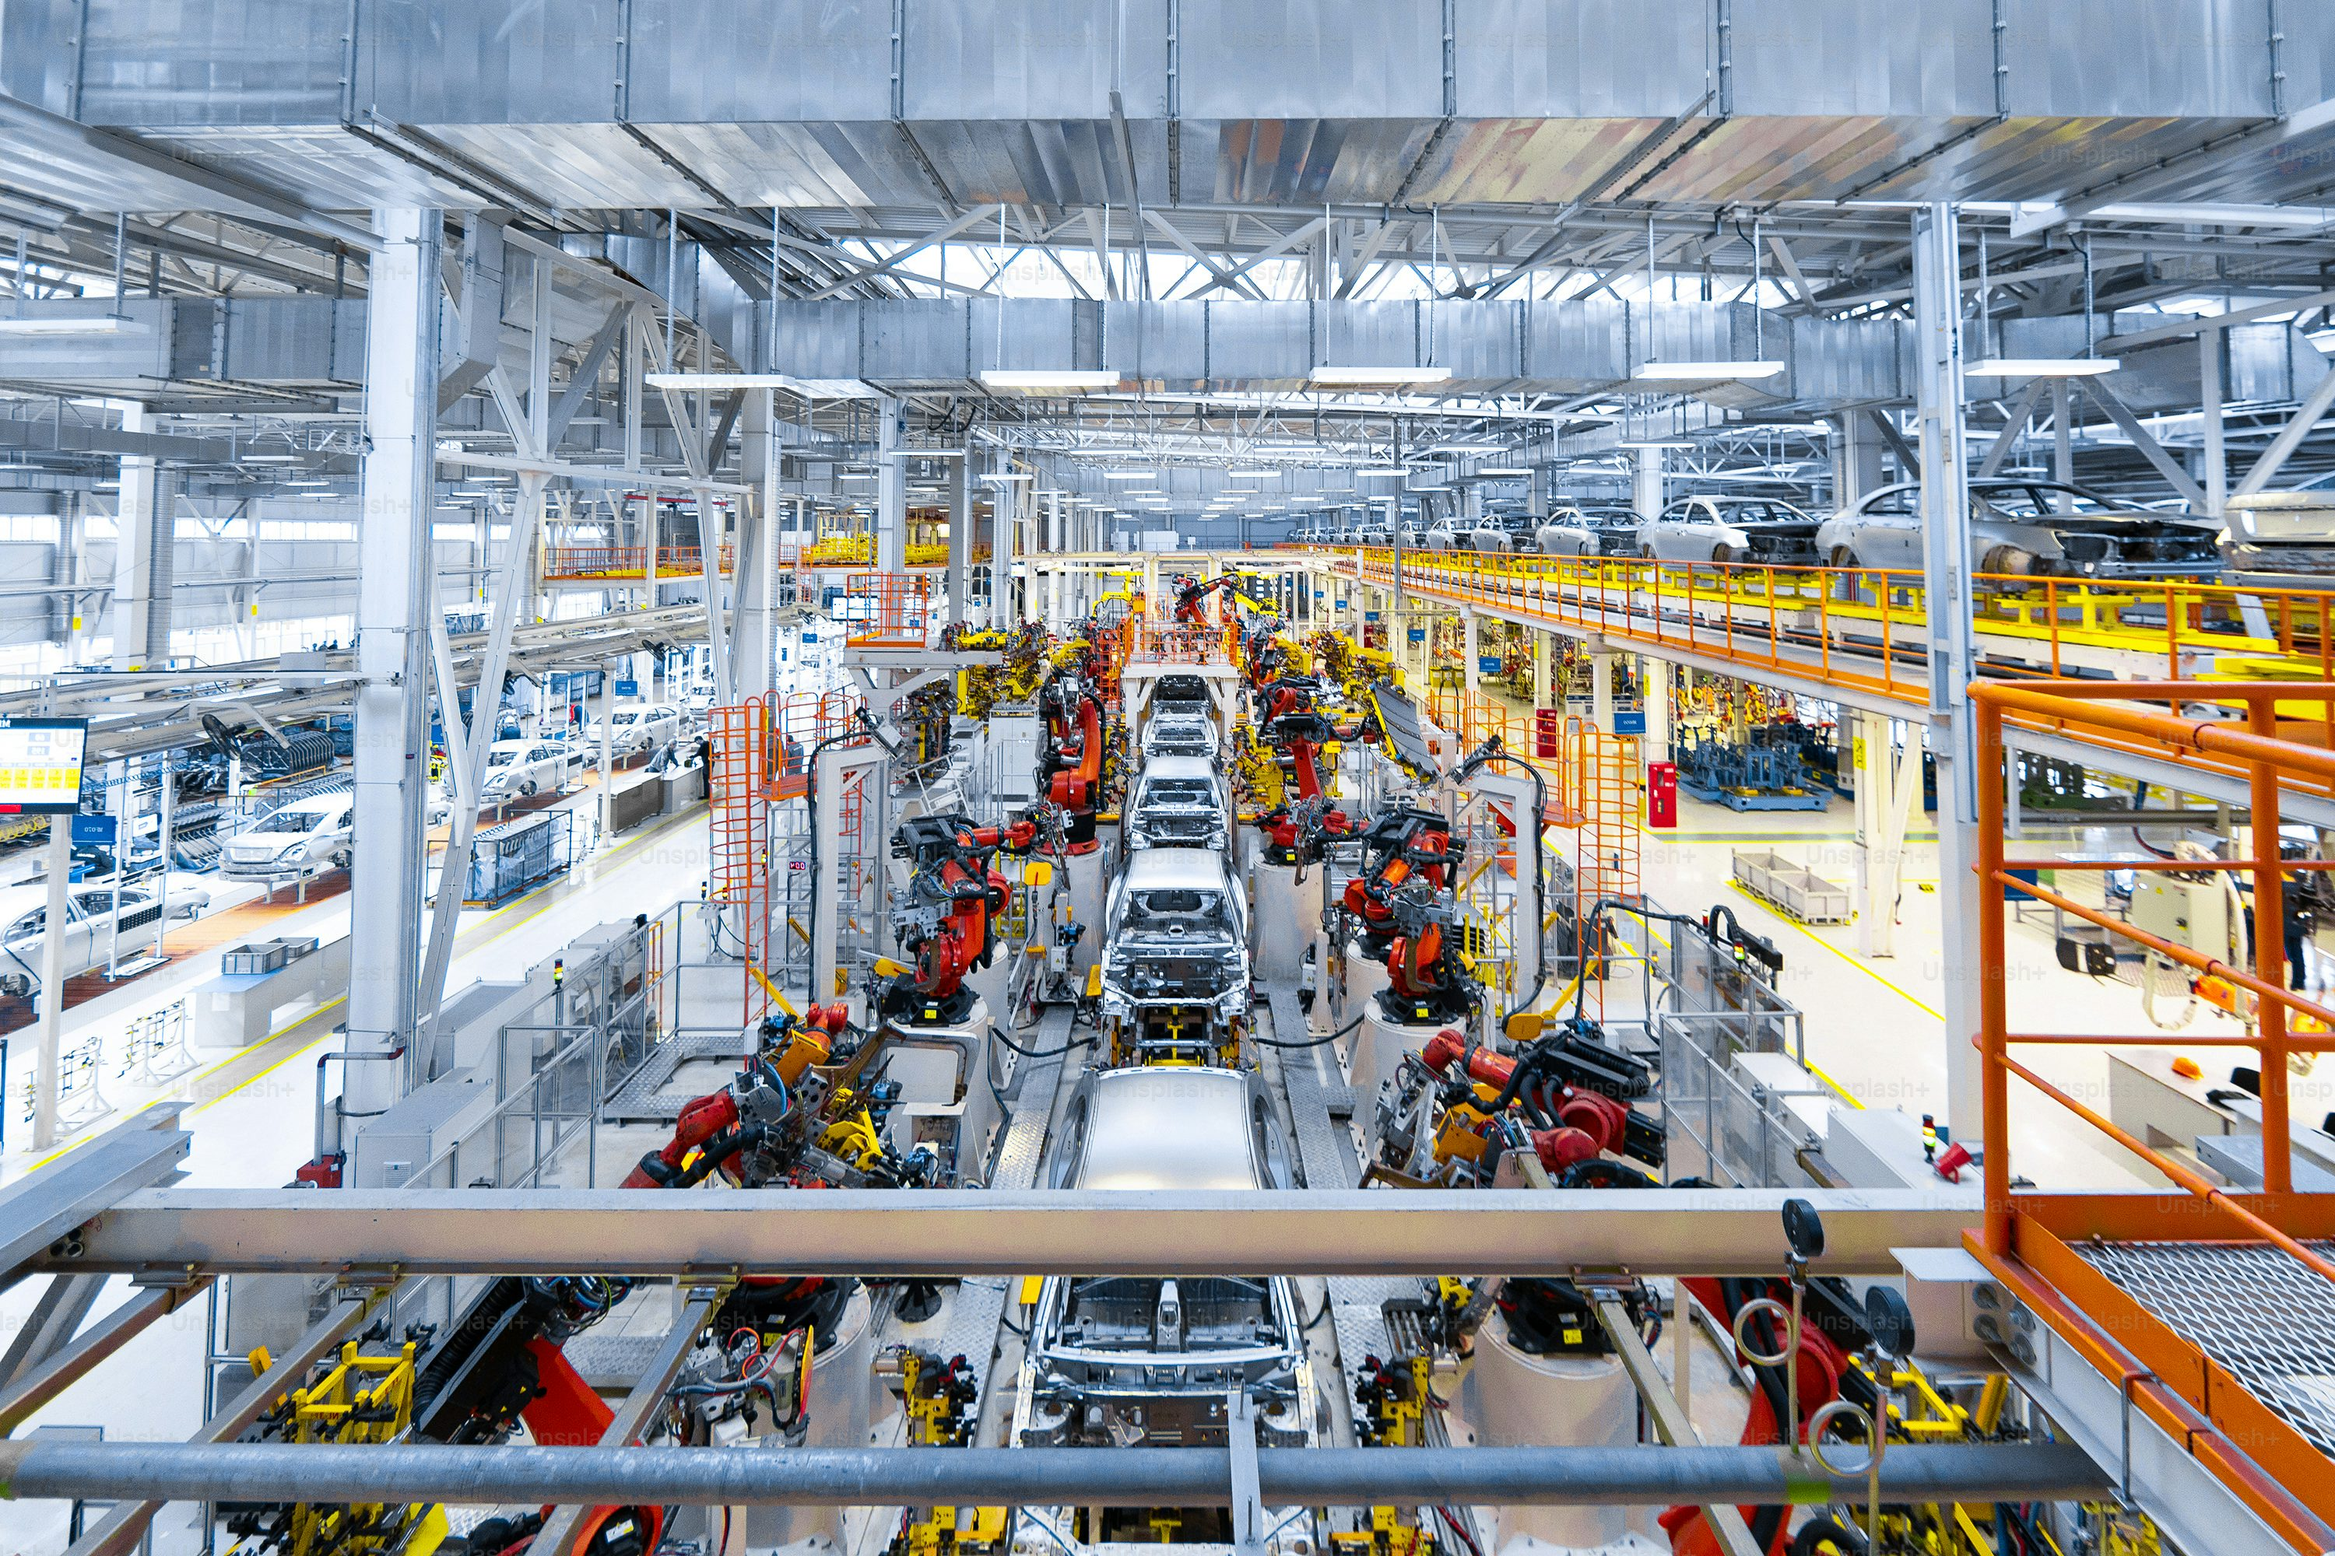
3. Indirect emissions become increasingly important

Slide 11
Conclusions
Global competition for batteries
Amount of fossil cars is a challenge, not just the share
Key elements for reaching GHG-goals:
  efficient use of vehicles and transport infrastructure
  reduced commuting through place independent work
  reduced (business) air travel
Very hard to see how goals can be reached without car volume reductions

Slide 12
More information will be given in the ConverStations by Hampus Berg Mårtensson and Jonas Åkerman

